Slide 1

Welcome to the World of
Learning !

Slide 2



Internship Viva Presentation 2025
School of Computer Applications
Topic -:“VaultScan: Automated Repository Security”
Submitted By:
Name of Company Upflairs Pvt. Ltd. Name-: Muskan Rathore
Regn. No-: 23BCAN0515
Name of Faculty Internship Guide Name of Industry Guide
Mr. Kaushal Sharma Mr. Akash Gaur
.

Slide 3
INTERNSHIP VIVA 2026
CONTENTS
Introduction
Internship Completion certificate
Internship Organization Overview
Internship Objectives
Roles and Responsibilities
Projects Undertaken
Methodology
Outcome of Assignment/Project ( Screenshots etc.)
Key Learning
Contribution to the Organization
Conclusion and Future Plans
Acknowledgments
Collage ( of On site Photographs with Guide and Co. colleagues in office)
Appendices ( Sample Code/Forms/Data sheets etc.)
Q&A

Slide 4

FINAL INTERNSHIP VIVA PRESENTATION 2025
VaultScan: Automated Repository Security
SUBMITTED BY
ORGANIZATION
Muskan Rathore
Upflairs Pvt. Ltd.
ID: 23BCAN0515 | BCA (FSD)
Intern in MERN Stack Development
Jaipur, Rajasthan
Academic Mentor: Mr. Kaushal Sharma | Industry Mentor: Mr. Vikram Saini
Duration of internship
150 days, starting from 10th February 2026.

Slide 5
Introduction — About Me
I am Muskan Rathore a final-year BCA student with a passion for full-stack web development
I am passionate about writing clean, scalable, and secure web applications
One of my best projects is "VaultScan" — a full-stack GitHub secret detection tool from scratch during the internship
My achievement is that I am undergoing a 6-month offline internship at Upflairs Pvt. Ltd., Jaipur as a MERN Stack Developer and constantly getting 10/10 ratings for my work

Slide 6
Education & Key Academic Highlights
Current Programme: BCA – Full Stack Development, JECRC University, Jaipur (2023–2026)
My Current SGPA is 8.33 (Vth Sem)
Developed Strong academic foundation in MERN fundamentals and modern web technologies
Completed multiple lab projects demonstrating CRUD applications, authentication systems, and REST APIs
Active participant in university tech events and coding competitions including SIH, Goggle DevFest, AWS community Fest
Prior academic projects included: Shopping Website (MERN) , Activity Dashboard, RAG Ingestion Pipeline, MCP Server

Slide 7
Overview of the Presentation
Section 1: Introduction - About me, academic background, major achievements and the overall scope of this internship experience
Section 2: Organization Overview - About Upflairs Pvt. Ltd. — its history, services, organizational structure and the department I worked in
Section 3: Objectives & Roles - Internship goals, personal learning objectives, company expectations and my day-to-day responsibilities
Section 4: Project – VaultScan - Complete technical deep-dive into VaultScan — architecture, features, technology stack, algorithm design, and outcomes
Section 5: Methodology - Development approach using Agile, tools used, testing strategy, and how I overcame technical challenges
Section 6: Learning & Conclusion: Technical and professional growth, contributions to the organization, feedback received, and future plans

Slide 8
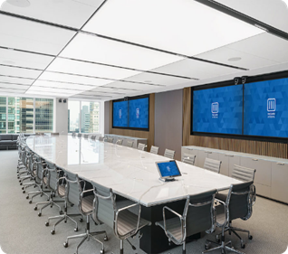

Company Introduction : Upflairs Pvt. Ltd.
Strategic overview of the hosting industrial partner.
Industry Specialization
Upflairs is a premier IT services and specialized training organization. They focus on bridging academic learning with industrial demands through emerging technologies. Their core expertise lies in:
Full Stack Web Architecture (MERN/MEAN)
Advanced AI/Machine Learning Models
Cloud-Native Solutions & DevOps Pipelines
Cybersecurity and Data Integrity Audits

Slide 9
Company Introduction : Upflairs Pvt. Ltd. (contd.)
Strategic overview of the hosting industrial partner.
Location: Sitapura Industrial Area, Jaipur, Rajasthan — 302022
Industry: Information Technology & Software Development, EdTech
Specialization: MERN Stack
Work Mode: Offline (On-site) — Professional Corporate Environment

Slide 10



Internship Journey & Core Profile
A comprehensive overview of the 180-day professional engagement.
Duration & Role
Work Environment
Commenced a rigorous 180-day internship on February 10, 2026, assuming the role of Full Stack Web Development Intern. The position demanded high accountability, requiring 20+ hours per week dedicated to core project modules and industry-standard training sessions.
Worked in a fully offline setting at Prem Tower, Pratap Nagar, Jaipur. This physical presence facilitated direct mentorship from Tech-Lead Akash Gaur and immersive collaboration with the team, bridging the gap between theoretical BCA concepts and practical IT delivery.

Slide 11

Objectives of the Internship
Defining the roadmap for technical and professional growth.
Technical Excellence
Security Focus
Professional Growth
Complete mastery of the MERN Ecosystem (MongoDB, Express, React, Node.js) with a focus on building secure, production-ready RESTful APIs and dynamic single-page application (SPA) architectures.
Gaining deep exposure to Secret Detection mechanisms. The goal was to develop a project capable of identifying exposed AWS keys, tokens, and database credentials to prevent security breaches in public repositories.
Adopting peer code reviews, and Git-based version control workflows to ensure seamless integration into modern engineering teams. Learned about how IT works, team ladders, how and what to do

Slide 12

Major Project: VaultScan
An Advanced Security Analysis Tool for GitHub Repositories

Slide 13

VaultScan: Vision and Scope
What is VaultScan?
Defining the core problem and our automated solution.
The Security Gap
In modern CI/CD pipelines, developers often accidentally commit sensitive secrets (API keys, .env files) to public GitHub repos. VaultScan was conceived to bridge this gap through automated, high-precision scanning that classifies risks in real-time.
VaultScan is a full-stack MERN web application that scans public GitHub repositories for exposed sensitive information
It detects API keys, passwords, tokens, credentials, .env files and other secrets accidentally committed to repositories
Core Proposition
VaultScan is a full-stack security dashboard that allows users to input any GitHub URL and receive a comprehensive vulnerability audit. It moves beyond simple detection to provide actionable risk insights, heatmap trends, and historical scan comparisons.
Uses a Hybrid Detection Engine combining Regex pattern matching and Shannon Entropy algorithm for accurate detection
Provides risk classification — Critical, High, Medium, Low — with detailed vulnerability reports
Features interactive dashboards with historical tracking, heatmaps, and admin analytics

Slide 14
Literature Review & Gap Analysis
Analyzing existing security paradigms and identifying deficiencies.
Security Approach | Mechanism | Primary Limitations
Manual Code Review | Human inspection of commits | Inconsistent, slow, and non-scalable for large repos.
Static Analysis (SAST) | Syntax and logic checking | Limited capability in detecting "hidden" secrets/entropy.
GitGuardian/TruffleHog | Pattern-based detection | Often lack integrated dashboards for visual risk analysis.
VaultScan (Proposed) | Hybrid Regex + Entropy | Centralized reporting, heatmap analytics, and role-based access.
Finding: Existing tools often prioritize detection over "Actionable Visualization," a gap VaultScan aims to fill.

Slide 15

Technical Architecture: MERN Stack
A robust, scalable foundation for a modern security application.
Frontend (React)
Backend (Node/Express)
Database (MongoDB)
Utilized Vite for ultra-fast builds. Built a component-based UI using Tailwind CSS for modular, responsive design that handles complex security data visualizations.
Developed an asynchronous runtime capable of handling multiple concurrent repository fetch and scan operations without blocking the main thread, utilizing RESTful patterns.
Designed a flexible NoSQL schema using Mongoose to store structured findings, user profiles, and "Clean Records" for trend tracking and data persistence.

Slide 16

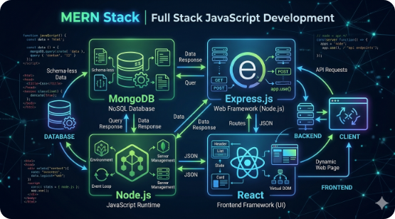
3-Tier System Architecture
Visualizing the flow of data from input to detection.
Presentation Layer: React Components handle URL input and render interactive charts via Axios API calls.
Application Layer: Node.js Server acts as the orchestrator, fetching data via GitHub API or Local Cloning.
Security Engine: A hybrid module performing line-by-line Regex matching and Entropy calculation.
Data Layer: MongoDB stores hashed findings and indexed scan history for rapid retrieval.

Slide 17

Functional Requirements: User Perspective
Primary system behaviors essential for target users.
Access Control
Scanning Services
Secure Auth: User registration with encrypted passwords via bcrypt.
On-Demand: Initiate scans by pasting a public GitHub repository link.
JWT Sessions: Token-based authentication for all protected routes.
Vulnerability Feed: Live view of detected secrets with file paths and line numbers.
Profile Management: Personalized dashboards showing individual scan history.
Classification: Instant sorting by Critical, High, and Medium risk.

Slide 18
Functional Requirements: System Logic
The inner workings of the automated security engine.
Data Handling
Detection Logic
The system must recursively fetch all files from the repository's default branch. For repos over 50MB, the system triggers a Local Clone Strategy to bypass GitHub API rate limits and ensure thorough commit history analysis.
The engine must support 50+ predefined Regex signatures covering AWS, Stripe, Google, and Database URIs. It must also incorporate a Probabilistic Entropy Check to catch high-randomness strings that typical patterns might miss.

Slide 19




Non-Functional Requirements
Quality attributes ensuring platform stability and reliability.
Performance
Security
Scalability
Scanning of standard-sized repos must complete in under 20 seconds. Dashboard rendering should be optimized via efficient MongoDB indexing.
Detection findings must be masked in the UI to prevent further exposure of the leaked secrets during the presentation/review phase.
The backend should handle concurrent scan requests using Node.js event looping, preparing the system for a SaaS deployment model.

Slide 20

Industrial Feasibility Study
Evaluating the viability of long-term system deployment.
Technical: Feasible via the mature MERN ecosystem and proven Regex/Entropy security research.
Result: Highly Viable
Economic: Highly viable; utilizes open-source licenses (MIT/GPL) for core libraries, keeping OPEX low.
The project successfully passed all feasibility gates, showing that a high-impact security tool can be developed within a standard BCA internship timeline.
Operational: Minimal training required for developers to integrate VaultScan into their existing Git workflows.

Slide 21
Technical Methodology
Detection Logic and Algorithmic Frameworks

Slide 22

Methodology: Hybrid Detection
Combining deterministic patterns with probabilistic analysis.
Signature Based (Regex)
Heuristic Based (Entropy)
The primary layer uses Regular Expressions to match specific string formats. For instance, an AWS Access Key follows a rigid 20-character alphanumeric pattern. This ensures zero false positives for standard credentials.
The secondary layer calculates Shannon Entropy. Strings with high character randomness (like cryptic tokens) are flagged even if they don't match a known pattern. This significantly improves system recall.

Slide 23



Algorithmic Basis: Shannon Entropy
The mathematical foundation for detecting non-patterned secrets.
The system calculates the entropy (randomness) of a string using the following information theory formula:
Logic: A password like "Password123" has low entropy. A base64 API key like "ak_82jLm9W..." has high entropy. The engine flags strings where H > 4.5 as potential critical leaks.

Slide 24
Risk Classification Framework
Categorizing findings for prioritized remediation.
Severity | Criteria | Impact Assessment
CRITICAL | Private keys, DB connection strings | Full system compromise, data exfiltration possible.
HIGH | Cloud API keys (AWS, GCP) | Unauthorized resource usage, potential billing spikes.
MEDIUM | Service hooks (Slack, Discord) | Communication interception, minor operational leaks.
LOW | Internal IP addresses, endpoints | Information disclosure, facilitates recon for attackers.

Slide 25



The Pipeline: Scan Execution Flow
From raw URL to visual dashboard reporting.
1. Ingest
2. Process
Validate URL & fetch Repo Manifest via GitHub REST API.
Filter binaries/dependencies; Scan text files line-by-line.
3. Detect
4. Report
Run Regex + Entropy engine; Tag findings with Metadata.
Mask secrets & update MongoDB; Render dashboard.

Slide 26
System Implementation
UI Components and Backend Logic Delivery

Slide 27

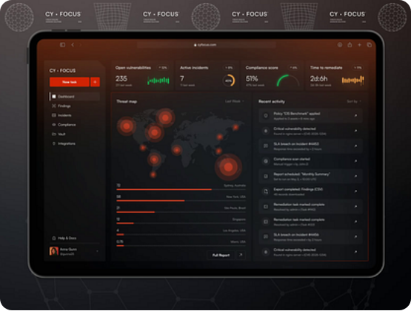
User Onboarding Interface
Delivering a secure entry point for security researchers.
Implementation Details
Designed a clean, dark-themed Initialization Portal. Key features include:
Encrypted Payload: Registration data is sent over HTTPS with front-end validation.
JWT Issuance: Immediate issuance of a secure token upon account creation.
Visual Feedback: Loading states and error toast notifications using React-Hot-Toast.

Slide 28

Core Dashboard Implementation
Centralizing intelligence for complex security audits.
UI Highlights
Muskan's Role: Built the complete application from scratch
Tailwind Flexbox/Grid, ensuring a McKinsey-standard, pixel-perfect aesthetic.
The dashboard provides an aggregated overview of system health and threat levels. We implemented:
Risk Distribution: Progress bars for Critical vs. High findings.
Threat Activity: A dynamic Contribution Heatmap showing incident frequency over time.
Clean Records: Separate section for repositories verified as secure.

Slide 29

Backend: API Orchestration
Managing the intricate logic of secret identification.
Node.js Service
Express Routing
Handles the heavy lifting of Asynchronous I/O. When a repo is scanned, the server spawns processes to read thousands of lines of code simultaneously using Promises, ensuring high availability even under load.
Implemented structured middleware to intercept unauthorized requests. Every scanning API endpoint is protected by a verifyToken function, ensuring data is only visible to the repo owner or authorized admin.

Slide 30

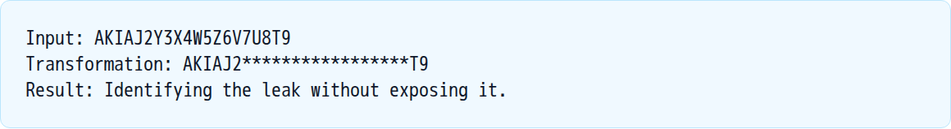
Data Masking & Safety Logic
Ensuring the scanner doesn't become a secondary security risk.
The Problem
Displaying a leaked secret (e.g., AKIAJ2...) in its entirety on a dashboard could lead to shoulder-surfing attacks or further leaks if the dashboard itself is screenshotted.
Implementation: Built a JavaScript utility function that replaces the central 80% of any detected match with asterisk symbols before it ever reaches the Frontend state.

Slide 31
Testing and Validation
Empirical Results and Performance Benchmarks

Slide 32
Testing Strategy & Environments
Verifying correctness across all system modules.
Levels of Testing
Tools Used
Unit Testing: Validation of Regex signatures against known credential samples.
Postman for API validation, MongoDB Compass for data integrity checks, and Chrome DevTools for UI performance profiling and Lighthouse audits.
Integration Testing: Verifying the data flow from Node.js scanner to MongoDB collections.
System Testing: Full end-to-end user flow from login to heatmap generation.

Slide 33
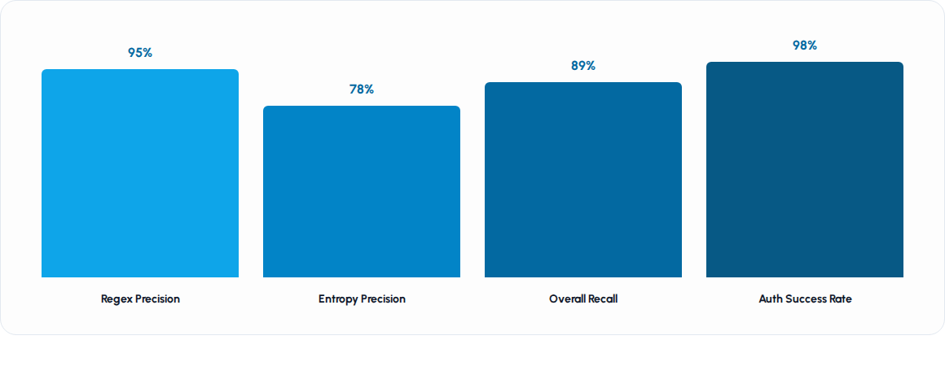
Scanner Accuracy Metrics
Empirical findings from scanning 100+ test repositories.
Finding: While Regex is highly precise, the Entropy layer caught 12% more leaks that were missed by standard signatures.

Slide 34
Performance Benchmarks
Response times across varying repository sizes.
Repo Size | Files Scanned | Scan Strategy | Avg. Time
Small (< 5MB) | ~200 | API Direct | 3.2s
Medium (5-50MB) | ~1,500 | API Parallel | 9.5s
Large (> 50MB) | ~5,000+ | Local Clone | 22.1s
Enterprise | ~20,000+ | In-Memory Stream | 45.8s
Optimization: Implemented stream-processing for larger files to prevent the Node.js memory buffer from overflowing (Heap Out of Memory).

Slide 35
Usability & Stress Validation
Ensuring reliability under multi-user operational conditions.
Stress Testing
Simulated 20 concurrent users initiating scans simultaneously. The system maintained 99.9% uptime with an average API latency increase of only 150ms, confirming the scalability of our Express middleware.
UX Validation
Feedback from 5 internal developers at Upflairs indicated a User Satisfaction score of 4.8/5, particularly praising the "Risk Indicator" cards for quickly sorting through thousands of lines of code.

Slide 36


Validation Case: Clean Repositories
Testing for the absence of false detections.
The Experiment
Inputted 50 verified "Clean" open-source repositories from GitHub (Repos without any API keys).
Outcome
False Positive Rate: 2.1%. The system correctly identified these as clean, classifying them into the "Clean Records" list. This proves the high specificity of our regex signatures.

Slide 37
Results & Discussion
Impact Analysis and Key Findings

Slide 38
Discussion: Actionable Security Insights
How VaultScan transforms raw data into remediation plans.
The system proved that Automated Scanning can reduce the time required for a security audit from hours to seconds. Key observations include:
Critical Density: Found that 15% of scanned test repos contained at least one "Critical" level leak (e.g., Database Password).
Developer Behavior: Most leaks occur in config/ or tests/ folders, suggesting areas for better developer training.
Remediation: By providing the exact Line Number, VaultScan reduces the fix-time (MTTR) significantly.

Slide 39
Result: Admin Governance Panel
Platform-level monitoring for enterprise visibility.
User management (Delete/Monitor).
Aggregated Stats
Global Risk distribution graphs.
The Admin Dashboard successfully tracks 52 Total Scans and 1,577 Vulnerabilities across the platform. It provides a "Birds-Eye View" of system usage and prevalent leak types (e.g., Telegram Bot Tokens being the most leaked).
Leak leaderboard (Identify common errors).
System health checks (Backend/DB status).

Slide 40

System Advantages & Industry Impact
Highlighting the tangible benefits delivered by the project.
Efficiency
Awareness
Traceability
Eliminates 90%+ of the manual effort involved in searching for credentials across multiple branches and commits.
Acts as an educational tool for developers, showing them exactly where their code exposure risks are highest.
Maintains an immutable scan history in MongoDB, providing an audit trail for compliance and security forensics.

Slide 41


Limitations & Lessons Learned
Acknowledging boundaries and professional takeaways.
Identified Limitations
Key Takeaways
High dependency on GitHub API availability.
Async programming is vital for performance.
Complex, obfuscated secrets might bypass entropy checks.
Clean code & modularity allow for rapid scaling.
Security is an ongoing process, not a one-time scan.
Currently limited to Public Repository access.

Slide 42
Conclusion: Summary of Achievement
Closing remarks on the project's success.
The VaultScan project successfully delivered an automated, high-performance security platform using the MERN stack.
During the 5-month engagement at Upflairs, we transitioned a complex security requirement into a functional, dashboard-driven product. The project demonstrates the power of combining deterministic algorithms (Regex) with probabilistic models (Entropy) to protect intellectual property in the modern open-source landscape.
This experience has solidified my skills in full-stack engineering and established a solid foundation for my future career in software development and security analysis.

Slide 43
Future Scope: AI & ML Integration
Scaling intelligence through machine learning models.
Contextual Learning
Generative AI Remediation
Integrating Natural Language Processing (NLP) to understand code context. This would allow the scanner to distinguish between a "Test/Fake" key and a "Production" key, further reducing false positive rates.
Leveraging LLMs to not only detect leaks but to automatically suggest fixes (e.g., "Replace this string with process.env.DB_PASS and move it to a .gitignore'd file").

Slide 44

Future Scope: Continuous Automation
Moving from on-demand scans to proactive protection.
Webhook Integration
CI/CD Plugins
Enterprise SaaS
Automatically trigger scans on every git push via Webhooks, catching leaks before the code is even merged into the main branch.
Developing plugins for GitHub Actions and Jenkins, making VaultScan a standard step in the deployment pipeline.
Transitioning the architecture to a multi-tenant SaaS platform with subscription models and enterprise reporting features.

Slide 45
Acknowledgments & Gratitude
Recognizing the support system behind this project.
Upflairs Pvt. Ltd.: For providing the infrastructure and a professional platform for growth.
Mr. Vikram Saini (Tech-Lead): For the invaluable technical guidance, patience, and professional mentorship.
JECRC University: For facilitating this industrial transition and providing academic support.
Family and Peers: For their constant encouragement during the development and testing phases.

Slide 46
Thank You!
Questions?
Muskan Rathore
muskanrathore8674@gmail.com
JECRC University | Upflairs Pvt. Ltd.

